Slide 3
Agenda
Chapter | Description
Advanced Rules | Advanced extensions techniques
Control Tasks | Defining and using control task
Custom Orchestration | Implementing custom orchestrators
Custom Listeners | Implementing custom listeners
Custom Actions | Triggers and Actions
Overthere essentials | Overthere API
Plugin Development | Plugin development essentials

Slide 4
Agenda
Chapter | Description
UI Plugin | UI Plugins step-by-step
Links | Useful links

Slide 5
Advanced rules
http://www.xebialabs.com

Slide 6
Advanced Rules and techniques
Introduction
This chapter will cover the following topics:
Refresh
XML rules syntax
Injecting variables with Python expressions
Reusing Jython code with modules
Steps macro
Useful XL Deploy types and method
Disabling rules
Using plugin steps
Creating custom steps
Get to know the variables
Using the rules engine context
Using properties on DeployedApplication
Checkpoints

Slide 7
Advanced Rules
Rule Definitions
Each rule
Must have a name that is unique across the whole system
Must have a scope
Must define the conditions under which it will run
Conditions in XML use umd.Deployed types
Can use the planning context to influence the resulting plan

Slide 8
Advanced Rules
Rule Scope : refresh
Pre-plan
Deployed
Plan
Post-plan

Slide 9
Advanced Rules
Rule Types : refresh
XML
Script

Slide 10
Advanced Rules
Rule Types : refresh
XML Rules
XML
Rule
Condition
Type
Operation
Expression
Steps

Slide 11
Advanced Rules
XML Rule example : refresh
<rules xmlns="http://www.xebialabs.com/xl-deploy/xl-rules">
<rule name="SuccessBaseDeployedArtifact" scope="deployed">
<conditions> <type>udm.BaseDeployedArtifact</type>
<type>udm.BaseDeployed</type>
<operation>CREATE</operation>
<expression>deployed is not None</expression>
<conditions> <steps> <noop>
<order>60</order>
<description expression="true">'Dummy step for %s' % deployed.name</description>
</noop>
</steps>
</rule>
</rules>

Slide 12
Advanced Rules
Objects available in rules (1) : refresh
The available objects in XLD Deploy rules definitions depend of the rule's scope
Object name | Type | Scope | Description
context | DeploymentPlanningContext | all | Use this to add steps and checkpoints to the plan
deployedApplication | DeployedApplication | all | Specifies which application version will be deployed to which environment
steps |  | all | Allows you to create steps from the step registry
Specification | DeltaSpecification | pre-plan post-plan | Contains the delta specification for the current deployment; see the Customization Manual for more information

Slide 13
Advanced Rules
Objects available in rules (2) : refresh
Object name | Type | Scope | Description
delta | Delta | deployed | Whether the deployed should be created, modified, destroyed, or left unchanged (noop); see the Customization Manual
deployed | Deployed | deployed | In the case of create, modify, or noop, this is the "current" deployed that the delta variable refers to; in the case of destroy, it is not provided
previousDeployed | Deployed | deployed | In the case of modify, destroy, or noop, this is the "previous" deployed that the delta variable refers to; in the case of create, this is not provided
deltas | Deltas | plan | Collection of all Deltas in the current InterleavedPlan

Slide 14
Advanced Rules
Objects available in rules (3) : refresh
Object name | Type | Scope | Description
controlService | ControlService | all | Gives you access to the ControlService
deploymentService | DeploymentService | all | Gives you access to the DeploymentService
inspectionService | InspectionService | all | Gives you access to the InspectionService
metadataService | MetadataService | all | Gives you access to the MetadataService
packageService | PackageService | all | Gives you access to the PackageService
permissionService | PermissionService | all | Gives you access to the PermissionService

Slide 15
Advanced Rules
Objects available in rules (4) : refresh
Object name | Type | Scope | Description
repositoryService | RepositoryService | all | Gives you access to the RepositoryService
roleService | RoleService | all | Gives you access to the RoleService
serverService | ServerService | all | Gives you access to the ServerService
taskService | TaskService | all | Gives you access to the TaskService
taskBlockService | TaskBlockService | all | Gives you access to the TaskBlockService
userService | UserService | all | Gives you access to the UserService
logger | Logger | all | Allows you to access the XL Deploy logs. Prints logs to namespace com.xebialabs.platform.script.Logging

Slide 16
Advanced Rules
XML rules syntax
Rules conditions in XML can be refined with the expression tag
<conditions>
<type>sql.ExecutedSqlScripts</type>
<operation>CREATE</operation>
<operation>MODIFY</operation>
<expression>deployed.postSqlProcedureArtifact is not None</expression>
</conditions>

Slide 17
Advanced Rules
XML rules syntax
Rules conditions in XML can be refined with the expression tag
<rule name="training.baseDeployed.CREATE_MODIFY" scope="deployed">
<conditions>
<type>udm.BaseDeployed</type>
<operation>CREATE</operation>
<operation>MODIFY</operation>
<expression>deployed.hasProperty("logDeployToAudit") and deployed.logDeployToAudit==True</expression>
</conditions> <steps> <noop> <order>70</order>
<description expression="true">"Log %s %s to audit trail" %(delta.operation, deployed.name)</description>
</noop> </steps> </rule>

Slide 18
Advanced Rules
Injecting variables with Python expressions
Steps may receive custom parameters (Freemarker or Jython steps)
Leverage Python expression to send complex parameters such as lists or maps
Caution to the difference between planning time injection (moment where the rule is evaluated) and step runtime

Slide 19
Advanced Rules
Injecting variables with Python expressions
<myVariable expression="true">
list(dict( [[d.name,d] for d in deployedApplication.deployeds if d.type=="jbossdm.EarModule"]) .values())
</myVariable>

Slide 20
Advanced Rules
Rules exercise : injecting variables
.
Add the types, rules and scripts present in material/training/rules - injecting variables
Import the infrastructure, environlent and app from the zip files in material/training/rules
preview an initial deployment of RULES_BASEEXT/StartOrderApp to RULES_BASEEXT/StartOrder-DEV
check the step preview on "Create StartOrderFileSpec on StartOrderServer"
execute
check the log of the Starting Artefacts steps
rollback

Slide 21
Advanced Rules
Rules exercise : injecting variables
List of artifacts
Artifact name : "MyFirstArtifact" order: "3" Artifact name : "MyThirdArtifact" order: "2" Artifact name : "MySecondArtifact" order: "1" Done

Slide 22
Advanced Rules
Rules exercise : injecting variables
adjust the rules to obtain this result :
List of artifacts
Artifact name : "MySecondArtifact" order: "1"
Artifact name : "MyThirdArtifact" order: "2"
Artifact name : "MyFirstArtifact" order: "3"
Done
modify the extension to start components according to the
value of the property startOrder

Slide 23
Advanced Rules
Reusing code with Jython modules
Jython scripts used from the Rules Engine may shared common logic or functions
Jython modules can be leveraged to achieve this
Build a Jython module
Place it under /lib
Reference it from your scripts

Slide 24
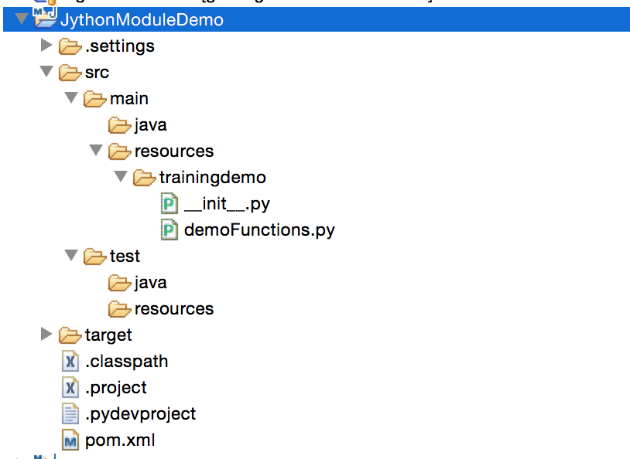
Advanced Rules
Reusing code with Jython modules

Slide 25
Advanced Rules
Reusing code with Jython modules
-Module function example
from com.xebialabs.deployit.plugin.api.reflect import Type
def instanceOf(ci, prefix, type, subtype=False):
t = Type.valueOf(prefix, type)
if (subtype):
return ci.getType().isSubTypeOf(t)
else: return ci.getType().instanceOf(t)

Slide 26
Advanced Rules
Reusing code with Jython modules
Rule example
<rule name="training_rule" scope="plan">
<planning-script-path>demoModule.py</planning-script-path>
</rule>

Slide 27
Advanced Rules
Reusing code with Jython modules
Planning script example
from trainingdemo import demoFunctions
for delta in deltas.deltas:
deployed = delta.deployedOrPrevious
if demoFunctions.instanceOf(deployed, "jbossdm","EarModule"):
logger.info("Deployed %s is a jbossdm.EarModule"%deployed.name)

Slide 28
Advanced Rules
Reusing code with Jython modules : exercise
Deploy the module present in material/rules - jython modules to your xldeploy server
Implement the previous rule with a pre-plan scope, adjust it to work with advtraining.StartOrderArtifactDeployed
Deploy application and check the logs

Slide 29
Advanced Rules
Steps macro
Introduced in XL Deploy 5.5
Allows for reusable definition of step(s) with optional parameters
Used as a regular step

Slide 30
Advanced Rules
Steps macro
Example from Puppet provisioner plugin
<step-macro name="puppet-apply-manifest">
<parameters>
<parameter name="targetHost" type="ci"
description="Target host on which to execute puppet apply"/>
<parameter name="description" type="string"
description="Description of puppet-apply step"/>
<parameter name="manifest" type="ci"
description="Manifest artifact"/>
</parameters>
<steps>
...
</steps>
</step-macro>

Slide 31
Advanced Rules
Steps macro
Example from Puppet provisioner plugin
<step-macro name="puppet-apply-manifest">
...
<steps>
<os-script>
<target-host expression="true">macro['targetHost']</target-host>
<description expression="true">macro['description']</description>
<script>puppet/provisioner/run-manifest</script>
<order>68</order>
<upload-artifacts>true</upload-artifacts>
<freemarker-context>
<manifestDeployed expression="true">
macro['manifest']
</manifestDeployed>
</freemarker-context>
</os-script>
</steps>
</step-macro>

Slide 32
Advanced Rules
Steps macro
Example from Puppet provisioner plugin
step = steps.puppet_apply_manifest(
targetHost=host,
manifest=p,
description="Provision {0} instance with
puppet provisioner {1} using manifest file {2}"
.format(deployed.name,p.name, p.file.name))

Slide 33
Advanced Rules
Useful XL Deploy types and methods
https://docs.xebialabs.com/xl-deploy/5.5.x/javadoc/udm-plugin-api/index.html
BaseConfigurationItem
BaseDeployed
DeltaSpecification
DeployedApplication
Type

Slide 34
Advanced Rules
Useful XL Deploy types and methods : examples
configurationItem.hasProperty()
configurarionItem.getProperty()
deployed.getContainer()
deployed.getDeployable()
deltaSpecification.getDeployedApplication()
deltaSpecification.getOperation()
deltaSpecification.isRollback()
deployedApplication.getDeployeds()
deployedApplication.getEnvironment()
deployedApplication.getVersion()
Type.valueOf()
type.instanceOf()
type.isSubTypeOf()
type.isSuperTypeOf()

Slide 35
Advanced rules
Exercise

Slide 36
Advanced Rules
Rule Exercise
Create rules to add noop steps to simulate DB backup and restore when deploying the RULES_BASEEXT/StartOrderApp application :
on deploy, add backup to preplan
on update, add backup to preplan
on undeploy add restore to postplan
on deploy rollback, add restore to postplan
on update rollback, add restore to preplan
on undeploy rollback, add backup to preplan

Slide 37
Advanced Rules
Disable rules
Rules can be disabled by using the disable rule tag :
<disable-rule name="some_rule_name" />

Slide 38
Advanced Rules
Disable rules
for methods using @Create, @Modify, @Destroy and @Noop annotations : use udm type name + method name + annotation
file.DeployedArtifactOnHost.executeCreate_CREATE

Slide 39
Advanced Rules
Disable rules
for methods using @Contributor, @PrePlanProcessor and @PostPlanProcessor : use full class name + method name
com.xebialabs.deployit.plugin.generic.container.LifeCycleContributor.restartContainers

Slide 40
Advanced Rules
Disable rules
For SQL plugin, see specifics at https://docs.xebialabs.com/xl-deploy/how-to/extend-the-xl-deploy-database-plugin.html
<disable-rule name="rules_sql.ExecutedSqlScripts.CREATE"/>
<disable-rule name="rules_sql.ExecutedSqlScripts.MODIFY"/>
<disable-rule name="rules_sql.ExecutedSqlScripts.DESTROY"/>

Slide 41
Advanced Rules
Plugin steps
Plugin usually implements specific steps to deal with target middleware / system
Plugins expose these steps : they can be reused from the Rules Engine
Each plugin documentation present the specific steps available if any : see Step Reference
When using existings steps, you may have to disable original rules and embed / extend the rules conditions in your extension

Slide 42
Advanced Rules
Plugin steps : WAS example
<wsadmin>
<order>70</order>
<script>was/application/deploy-application.py</script>
</wsadmin>
<wsadmin>
<order>80</order>
<description>Synchronize node</description>
<script>was/base/synchronize-node.py</script>
<python-context>
<nodeName expression="true">deployed.container.node.name</nodeName>
</python-context>
</wsadmin>

Slide 43
Advanced Rules
Plugin steps : Weblogic example
<wlst>
<order>70</order>
<script>wls/application/deploy-application.py</script>
</wlst>
<wlst>
<order>90</order>
<description>Start Application</description>
<script>wls/application/start-application.py</script>
</wlst>

Slide 44
Advanced Rules
Plugin steps : JBossdm example
<jboss-cli>
<order>60</order>
<description expression="true">"Deploying application '%s'"
% deployed.name</description>
<script>jboss/dm/application/install-ear.py</script>
<python-context>
<container expression="true">deployed.container</container>
</python-context>
<additional-libraries>
<value>jboss/dm/application/application-lib.py</value>
</additional-libraries>
</jboss-cli>

Slide 45
Advanced Rules
Creating custom steps
Custom steps allow you to extends the rule engines for custom purposes
Usually steps are quite generic actions : file copy, file rights changes, sending emails, ...
Custom steps are implemented in Java (... so use rules engine and steps macro in the first place)
Build and deploy in /plugins directory

Slide 46
Advanced Rules
Creating custom steps
import com.xebialabs.deployit.plugin.api.flow.Step;
import com.xebialabs.deployit.plugin.api.rules.StepMetadata;
import com.xebialabs.deployit.plugin.api.flow.Step;
@StepMetadata(name = "my-custom-step")
class UsefulStep implements Step {
...
}
<rule ...>
<conditions>...</conditions>
<steps>
<my_custom_step>
...
</my_custom_step>
</steps>
</rule>

Slide 47
Advanced Rules
Creating custom steps
Implement the interface Step
int getOrder();
String getDescription();
StepExitCode execute(ExecutionContext ctx) throws Exception;

Slide 48
Advanced Rules
Creating custom steps
Use @com.xebialabs.deployit.plugin.api.rules.StepParameter
@StepParameter(name = "freemarkerContext",
description = "Dictionary that contains all values
available in the template",
required = false, calculated = true)
private Map<String, Object> vars = new HashMap<>();
<steps>
<manual>
...
<freemarker-context>...</freemarker-context>
...
</manual>
</steps>

Slide 49
Advanced Rules
Creating custom steps
Step post construct : allows you to initialize your step
import com.xebialabs.deployit.plugin.api.rules.StepPostConstructContext;
import com.xebialabs.deployit.plugin.api.rules.RulePostConstruct;
@StepParameter(name="defaultHostURL", description="The URL to contact first",
required=true, calculated=true)
private String defaultUrl;
@RulePostConstruct
private void lookupDefaultUrl(StepPostConstructContext ctx) {
if (defaultUrl==null || defaultUrl.equals("")) {
Repository repo = ctx.getRepository();
Delta delta = ctx.getDelta();
defaultUrl = findDefaultUrl(delta, repo); // to be implemented yourself
}
}

Slide 50
Advanced Rules
Exercise: Custom step

Slide 51
Advanced Rules
Rule Exercise : custom step
Review plugin at https://github.com/xebialabs-community/xld-deployed-artifact-steps-plugin
src/main/java/ext/deployit/community/extra/steps/DeleteArtifactStep.java
Download and install this plugin
Create an extension that uses these steps

Slide 52
Advanced Rules
Understanding the variables available
http://blog.xebialabs.com/2015/01/05/xl-deploy-variables-demystified-part-1/
http://blog.xebialabs.com/2015/01/06/xl-deploy-variables-demystified-part-2/

Slide 53
Advanced Rules
Exercise
List the variables available to your rule script

Slide 54
Advanced Rules
Exercise
Create a pre-plan rule triggering a planning script
Use the dir() function and the logger object to output available variable names to XL Deploy log

Slide 55
Advanced Rules
Using the rules engine context
The context variable allows for sharing state and values between rules (similar to a key/value map)
Contexts are bound to scope : 1 context for pre-plan, 1 context for deployed and plan, and 1 context for post-plan
context.setAttribute("myAttribute","BLUE")
myAttribute = context.getAttribute("myAttribute")
logger.info("myAttribute is set to %s"%myAttribute)

Slide 56
Advanced Rules
DeployedApplication properties
Properties can be added to DeployedApplication
Non hidden properties will be available on the deployment properties screen
Hidden transient properties can be useful to carry deployment time values
These properties are used from your contributors
<type-modification type="udm.DeployedApplication">
<property name="forceServerRestart" kind="boolean" required="false"
default="false" description="Force Server restarts"/>
<property name="Jira Deployment ticket" required="true"
default="PLEASE_PROVIDE_JIRA_TICKET"
description="Provide the Jira ticket number for this deployment"/>
<property name="__deploymentState__" kind="String" transient="true"
hidden="true" required="false"/>
</type-modification>

Slide 57
Advanced Rules
Checkpoints
XL Deploy uses checkpoints to build rollback plans
Are defined by inserting after a step
Scope must be deployed
One checkpoint by rule
Use attribute completed="DESTROY" completed="CREATE" on MODIFY rule

Slide 58
Advanced Rules
Checkpoints
consider the following types
<type type="advtraining.BaseServer" extends="udm.BaseContainer"
description="Advanced training : base server">
<property name="host" kind="ci"
referenced-type="overthere.Host" as-containment="true"/>
<property name="home" description="Home directory for the server"/>
</type>
<type type="advtraining.BaseArtifactDeployed" extends="udm.BaseDeployedArtifact"
deployable-type="advtraining.BaseArtifact" container-type="advtraining.BaseServer"
description="Artifact that can be deployed to an example server">
<generate-deployable type="advtraining.BaseArtifact"
extends="udm.BaseDeployableFileArtifact"/>
</type>

Slide 59
Advanced Rules
Checkpoints
Consider the following rules
<rule name="advtraining.BaseArtifactDeployed.CREATE" scope="deployed">
<conditions>
<type>advtraining.BaseArtifactDeployed</type>
<operation>CREATE</operation>
</conditions>
<steps>
<upload>
<order>70</order>
<description>Upload base file</description>
<target-path expression="true">deployed.container.home +
deployed.container.host.os.fileSeparator + deployed.file.name</target-path>
</upload>
...

Slide 60
Advanced Rules
Checkpoints
Consider the following rules
<os-script upload="false">
<order>71</order>
<description>Install base file</description>
<script>advtraining/base/scripts/install-artifact</script>
</os-script>
</steps>
</rule>

Slide 61
Advanced Rules
Checkpoints
<rule name="advtraining.BaseArtifactDeployed.MODIFY" scope="deployed">
<conditions>
<type>advtraining.BaseArtifactDeployed</type>
<operation>MODIFY</operation>
</conditions>
<steps>
<os-script upload="false">
<script>advtraining/base/scripts/uninstall-artifact</script>
<freemarker-context>
<previousDeployed expression="true">delta.previous</previousDeployed>
</freemarker-context>
</os-script>
...

Slide 62
Advanced Rules
Checkpoints
<delete>
<description>Delete base file</description>
<target-path expression="true">previousDeployed.container.home
+ previousDeployed.container.host.os.fileSeparator
+ previousDeployed.file.name</target-path>
</delete>
...

Slide 63
Advanced Rules
Checkpoints
<upload>
<order>70</order>
<description>Upload base file</description>
<target-path expression="true">deployed.container.home
+ deployed.container.host.os.fileSeparator
+ deployed.file.name</target-path>
</upload>
<os-script upload="false">
<order>71</order>
<description>Install base file</description>
<script>advtraining/base/scripts/install-artifact</script>
</os-script>
</steps>
</rule>

Slide 64
Advanced Rules
Checkpoints
<rule name="advtraining.BaseArtifactDeployed.DESTROY" scope="deployed">
<conditions>
<type>advtraining.BaseArtifactDeployed</type>
<operation>DESTROY</operation>
</conditions>
<steps>
<os-script upload="false">
<script>advtraining/base/scripts/uninstall-artifact</script>
<freemarker-context>
<previousDeployed expression="true">delta.previous</previousDeployed>
</freemarker-context>
</os-script>
...

Slide 65
Advanced Rules
Checkpoints
<delete>
<description>Delete base file</description>
<target-path expression="true">previousDeployed.container.home
+ previousDeployed.container.host.os.fileSeparator
+ previousDeployed.file.name</target-path>
</delete>
</steps>
</rule>

Slide 66
Advanced Rules
Checkpoints
perform an initial deployment of BaseApp 1.0 and validate
perform an undeploy with rollback : put a pause after the upload step and execute
when task reach the pause step, perform a rollback
examine the rollback plan
execute
modify the extension to use checkpoints
perform initial deployment, updates and rollback with the checkpoints

Slide 67
Advanced Rules
Checkpoints
<rule name="advtraining.BaseArtifactDeployed.CREATE" scope="deployed">
<conditions>
<type>advtraining.BaseArtifactDeployed</type>
<operation>CREATE</operation>
</conditions>
<steps>
<upload>
<order>70</order>
<description>Upload base file</description>
<target-path expression="true">deployed.container.home
+ deployed.container.host.os.fileSeparator
+ deployed.file.name</target-path>
</upload>
<checkpoint/>
...

Slide 68
Advanced Rules
Checkpoints
<os-script upload="false">
<order>71</order>
<description>Install base file</description>
<script>advtraining/base/scripts/install-artifact</script>
</os-script>
</steps>
</rule>

Slide 69
Advanced Rules
Checkpoints
<rule name="advtraining.BaseArtifactDeployed.MODIFY" scope="deployed">
<conditions>
<type>advtraining.BaseArtifactDeployed</type>
<operation>MODIFY</operation>
</conditions>
<steps>
<os-script upload="false">
<script>advtraining/base/scripts/uninstall-artifact</script>
<freemarker-context>
<previousDeployed expression="true">delta.previous</previousDeployed>
</freemarker-context>
</os-script>
<checkpoint completed="DESTROY"/>
...

Slide 70
Advanced Rules
Checkpoints
<delete>
<description>Delete base file</description>
<target-path expression="true">previousDeployed.container.home
+ previousDeployed.container.host.os.fileSeparator
+ previousDeployed.file.name</target-path>
</delete>
...

Slide 71
Advanced Rules
Checkpoints
<upload>
<order>70</order>
<description>Upload base file</description>
<target-path expression="true">deployed.container.home
+ deployed.container.host.os.fileSeparator
+ deployed.file.name</target-path>
</upload>
<checkpoint completed="CREATE"/>
<os-script upload="false">
<order>71</order>
<description>Install base file</description>
<script>advtraining/base/scripts/install-artifact</script>
</os-script>
</steps>
</rule>

Slide 72
Advanced Rules
Checkpoints
<rule name="advtraining.BaseArtifactDeployed.DESTROY" scope="deployed">
<conditions>
<type>advtraining.BaseArtifactDeployed</type>
<operation>DESTROY</operation>
</conditions>
<steps>
<os-script upload="false">
<script>advtraining/base/scripts/uninstall-artifact</script>
<freemarker-context>
<previousDeployed expression="true">delta.previous</previousDeployed>
</freemarker-context>
</os-script>
<checkpoint/>
...

Slide 73
Advanced Rules
Checkpoints
<delete>
<description>Delete base file</description>
<target-path expression="true">previousDeployed.container.home
+ previousDeployed.container.host.os.fileSeparator
+ previousDeployed.file.name</target-path>
</delete>
</steps>
</rule>

Slide 74
Control tasks
http://www.xebialabs.com

Slide 75
Control tasks
Introduction
This chapter will cover the following topics:
Introduction to control tasks
XML definition
Delegates
Invoking control tasks from CLI
Tips

Slide 76
Control tasks
Introduction
Controls tasks generate a task that can be executed on demand
Leverage the Step interface (control task : list of steps)
Controls tasks are archived
Introduced by the method tag in synthetic.xml

Slide 77
Control tasks
Add a control task
Can be added with the @ControlTask Java annotation on the CI class
@ControlTask(description = "Start the Apache webserver")
public List<Step> start() {
// Should return actual steps here
return newArrayList();
}

Slide 78
Control tasks
Add a control task
Can be added with the @Delegate Java annotation on a delegate class
Control task definition on CI will reference this delegate
class MyControlTasks {
public MyControlTasks() {}
@Delegate(name="startApache")
public List<Step> start(ConfigurationItem ci, String method, Map<String, String> arguments) {
// Should return actual steps here
return newArrayList();
}
}

Slide 79
Control tasks
Add a control task
In synthetic.xml
<type-modification type="www.ApacheHttpdServer">
<method name="startApache" label="Start the Apache webserver"
delegate="startApache" argument1="value1" argument2="value2"/>
</type-modification>

Slide 80
Control tasks
Using parameters
Can be defined in synthetic.xml or in Java
<type type="www.ApacheParameters" extends="udm.Parameters">
<property name="force" kind="boolean" />
</type>
<type-modification type="www.ApacheHttpdServer">
<method name="start" />
<method name="stop" parameters-type="www.ApacheParameters" />
<method name="restart">
<parameters>
<parameter name="force" kind="boolean" />
</parameters>
</method>
</type-modification>

Slide 81
Control tasks
Delegates
Delegates from the generic plugin (use Freemarker)
see https://docs.xebialabs.com/xl-deploy/concept/control-task-delegates-in-the-xl-deploy-generic-plugin.html
shellScript
localShellScript
shellScripts
localShellScripts

Slide 82
Control tasks
ShellScript delegate
<method name="ping" delegate="shellScript"
script="tc/ping.sh"
classpathResources="tc/ping.py"/>

Slide 83
Control tasks
ShellScripts delegate
<method name="startAndWait" delegate="shellScripts"
scripts="start:tc/start.sh,tc/tailLog.sh"
startClasspathResources="tc/start.jar"
startTemplateClasspathResources="tc/password.xml"
classpathResources="common.jar"/>

Slide 84
Control tasks
JythonScript delegate
Delegate is "jythonScript"
Allows for Jython script execution
see http://blog.xebialabs.com/2016/02/24/xl-deploy-control-task-managing-repository/
<type-modification type="udm.Dictionary">
<method name="getProperties" label="Add Raw Properties.."
description="Pulls dictionary values from raw properties"
delegate="jythonScript"
script="utils/addProperties.py">
<parameters>
<parameter name="text" size="large" />
</parameters>
</method>
</type-modification>

Slide 85
Control tasks
Invoking control task with CLI
Useful CLI methods :
deployit.createControlTask(Control control) : String
deployit.executeControlTask(String taskName, ConfigurationItem ci) : void
deployit.prepareControlTask(ConfigurationItem ci, String taskName) : Control

Slide 86
Control tasks
Invoking control task with CLI
Examples
server = repository.read('Infrastructure/demoHost/demoServer')
deployit.executeControlTask('start', server)
server = repository.read('Infrastructure/demoHost/demoServer')
control = deployit.prepareControlTask(server, 'methodWithParams')
control.parameters.values['paramA'] = 'value'
taskId = deployit.createControlTask(control)
deployit.startTaskAndWait(taskId)

Slide 87
Control tasks
Invoking control task with CLI
Examples
def testGlassfishDomain(ci):
result = GlassfishCommandResult()
try:
task = deployit.prepareControlTask(ci,"listVirtualServers")
id = deployit.createControlTask(task)
deployit.startTaskAndWait(id)
ti = tasks.steps(id)
logging.info("%s ti.state %s"%(ci,ti.state))
printSteps(id)
result.domain = ci.id
if (str(ti.state).startswith("STOPPED")):
result.state = "FAILED"
else:
result.state = "OK"

Slide 88
Control tasks
Invoking control task with CLI
Examples
#Close/cancel task here
if result.state == "FAILED":
deployit.cancelTask(id)
return result
except:
logging.error("Error occurred %s"%sys.exc_info()[0])
logging.error("Error occurred %s"%sys.exc_info()[1])
logging.error("Error occurred %s"%sys.exc_info()[2])
result.state = "FAILED"
return result

Slide 89
Control tasks
Delegate example
This example show how to :
Create a custom delegate class
Add a Jython step in the control task
How to reuse existing connection test steps**
** Disclaimer : these steps are not public and subject to change.

Slide 90
Control tasks
Delegate example
package com.xebialabs.deployit.plugin.cyberark;
import java.util.List;
import java.util.Map;
import com.google.common.collect.Lists;
import com.xebialabs.deployit.plugin.api.flow.Step;
import com.xebialabs.deployit.plugin.api.udm.ConfigurationItem;
import com.xebialabs.deployit.plugin.api.udm.Delegate;
import com.xebialabs.deployit.plugin.api.udm.Parameters;
import com.xebialabs.deployit.plugin.overthere.step.CheckCommandExecutionStep;
import com.xebialabs.deployit.plugin.overthere.step.CheckFileTransferStep;
import com.xebialabs.deployit.plugin.overthere.Host;
import static com.google.common.base.Preconditions.checkArgument;
import com.xebialabs.deployit.plugin.steps.JythonStep;

Slide 91
Control tasks
Delegate example
public class CyberArkCheckConnectionDelegate {
@Delegate(name = "cyberArkconnectionChecker")
public static List<Step> executedScriptDelegate(ConfigurationItem item, String name,
Map<String, String> args, Parameters params) {
checkArgument(item instanceof Host,
"the cyberArkconnectionChecker delegate is for 'overthere.Host' subtypes only");
List<Step> l = Lists.<Step>newArrayList(
new CheckFileTransferStep((Host) item),
new CheckCommandExecutionStep((Host) item));
if (item.hasProperty("cyberArkAim") && item.<Boolean>getProperty("cyberArkAim")){
JythonStep step = new JythonStep();
step.setOrder(0);
step.setScriptPath(item.<String>getProperty("controlTaskCheckConnectionScript"));
step.setDescription("CyberArk credentials lookup and injection for "+item.getId());
step.getJythonContext().put("callContext", "cyberArkCtCheckConnection");

Slide 92
Control tasks
Delegate example
step.getJythonContext().put("host", (Host) item);
step.getJythonContext().put("deployedApplication", null);
step.getJythonContext().put("specification",null);
l.add(0, step);
}
return l;
}
}

Slide 93
Control tasks
Control task exercise
add a control task on your hosts to execute a ping command

Slide 94
Custom orchestration
http://www.xebialabs.com

Slide 95
Custom orchestration
Introduction
This chapter will cover the following topics:
UDM engine phases
Introduction to the Orchestration API
Jython orchestration
Example Jython orchestrator
Exercise

Slide 96
Custom orchestration
Deployment steps
A deployment involves the following phases:
Specification
Delta analysis
Orchestration
Planning
Execution

Slide 97
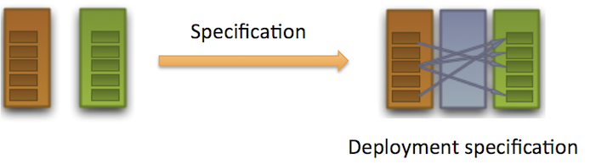
Custom orchestration
Deployment specification
Deployment begins with a deployment specification, where the engine gets the mapping of deployables to containers

Slide 98
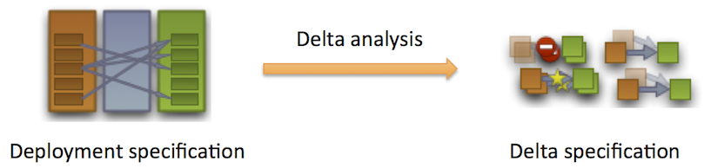
Custom orchestration
Deployment – Delta analysis
Step 2 : XL Deploy performs delta analysis to determine which deployeds need to be created, modified, destroyed or left as-is by comparing the current state with the specified state

Slide 99
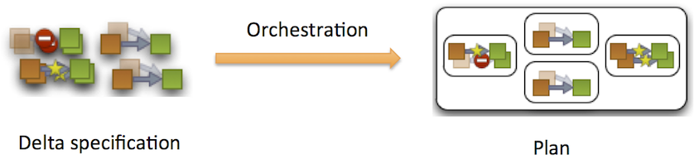
Custom orchestration
Deployment – Orchestration
-Step 3 : One or multiple orchestrators are invoked in order to build the deployment plan (and sub-plans)

Slide 100
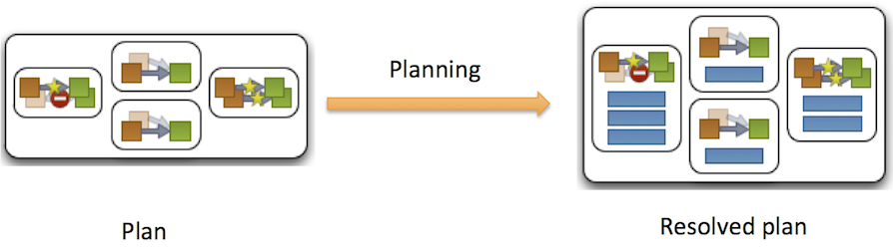
Custom orchestration
Deployment – Planning
Step 4: The delta specification is translated into a deployment plan by

Slide 101
Custom orchestration
Deployment – Planning
Every Deployed specifies what steps need to be performed to create, modify or destroy them, e.g. deploy an EAR on WAS cluster, configure a datasource or copy a folder to a host.
A Contributor can define steps that concern more than one Deployed, e.g. synchronize nodes in a WAS cell or restart WLS servers after a deployment.

Slide 102
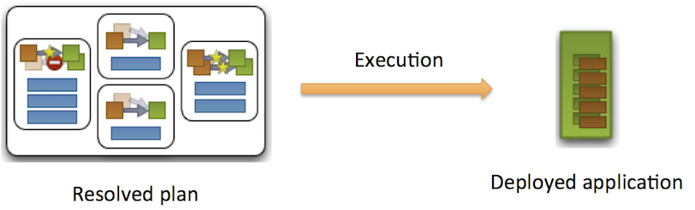
Custom orchestration
Deployment – Execution
Step 5: The steps in the deployment plan are executed, in order.

Slide 103
Custom orchestration
Orchestration API
The orchestration API consists in :
The Orchestrator interface
The @Orchestrator annotation
The objects defined in the com.xebialabs.deployit.engine.spi.orchestration package

Slide 104
Custom orchestration
Orchestration API
The Orchestrator interface
package com.xebialabs.deployit.engine.spi.orchestration
interface Orchestrator{
public Orchestration orchestrate(DeltaSpecification deltaSpec);
}
The @Orchestrator annotation
@Orchestrator.Metadata(name = "my-orchestrator")
public class MyOrchestrator implements Orchestrator {
}

Slide 105
Custom orchestration
Orchestration API
The orchestrate methods must return an Orchestration object to XL Deploy
This Orchestration object contains the list of delta arranged according to the orchestrator implementation
It can contain one or multiple plans and subplans
The following objects allow the creation of plans and subplans :
InterleavedOrchestration
SerialOrchestration
ParallelOrchestration

Slide 106
Custom orchestration
Orchestration API
Orchestrations.interleaved(String description, List<Delta> operations)
: InterleavedOrchestration
Returns an InterleavedOrchestration from a list of Delta

Slide 107
Custom orchestration
Orchestration API
Orchestrations.serial(String description, List<Orchestration> orchestrations)
: SerialOrchestration
Returns a SerialOrchestration : the orchestration list are subplans that will be executed sequentially

Slide 108
Custom orchestration
Orchestration API
Orchestrations.parallel(String description, List<Orchestration> orchestrations)
: ParallelOrchestration
Returns a ParallelOrchestration : the orchestration list are subplans that will be executed in parallel

Slide 109
Custom orchestration
Orchestration API
Orchestrator process the list of delta and apply the orchestration logic :
from the delta you can access the deployedApplication, the deployed and its associated information such as the container
Care must be taken not to omit any delta
for (Delta d : spec.getDeltas()){
if (d.getDeployed().getContainer().getType()....){
}
}

Slide 110
Custom orchestration
Orchestration in Jython
See community plugin at https://github.com/xebialabs-community/xld-jython-orchestrator-plugin
Orchestration in Jython example
from com.xebialabs.deployit.engine.spi.orchestration import Orchestrations;
def deployedOrPrevious(delta):
return delta.getDeployed() if delta.getDeployed() else delta.getPrevious()
def to_container(delta):
return deployedOrPrevious(delta).getContainer()
def containers():
return set(map(to_container, deltas))
def deltasForContainer(container):
return filter( lambda delta: deployedOrPrevious(delta).getContainer().getId()
== container.id, deltas)
...

Slide 111
Custom orchestration
Orchestration in Jython example
logger.info("parallelByContainer.py begin")
orchestrations = []
logger.info("Deltas %s"%deltas)
sortedContainers = sorted(containers(), key=lambda container: container.name)
for container in sortedContainers:
deltasContainer = deltasForContainer(container)
orchestrations.append(
Orchestrations.interleaved("Deploy to container %s"%container.name,
deltasContainer))
orchestration.setOrchestration(Orchestrations.parallel(planLabel, orchestrations))
logger.info("orchestratorName %s"%orchestratorName)
logger.info("orchestratorScriptName %s"%orchestratorScriptName)
logger.info("planlabel %s"%planLabel)
logger.info("parallelByContainer.py end")

Slide 112
Custom orchestration
Custom orchestration exercise
install the provided jython-orchestrator-plugin
duplicate the example serial-by-container jython code to ext/jython-orchestrators/serial-by-container-descending.py
adjust the code to orchestrate by container name sorted in descending order
test a petclinic deployment to DUAL-ACC

Slide 113
Custom listeners
http://www.xebialabs.com

Slide 114
Custom listeners
This chapter will cover the following topics:
Introduction to listeners
The listener API
Example Java listener
Exercise

Slide 115
Custom listeners
Introduction
Listeners are part of XL Deploy framework and extension point
See documentation at https://docs.xebialabs.com/xl-deploy/how-to/implement-custom-xl-deploy-plugpoints.html

Slide 116
Custom listeners
Introduction
Listeners can react to events
Two types of events : notification and commmands
Notification : a specific action has been executed
Command : a specific action is about to be executed

Slide 117
Custom listeners
Listening for notification
Examples notification:
The system is started or stopped
A user logs into or out of the system
A CI is created, updated, moved or deleted
A security role is created, updated or deleted
A task (deployment, undeployment, control task or discovery) is started, cancelled or aborted

Slide 118
Custom listeners
Listener API
The listener API consists mainly in :
The @DeployitEventListener annotation
The (nl.javadude.t2bus) @Subscribe annotation

Slide 119
Custom listeners
Notification listener example
import nl.javadude.t2bus.Subscribe;
import com.xebialabs.deployit.engine.spi.event.AuditableDeployitEvent;
import com.xebialabs.deployit.engine.spi.event.DeployitEventListener;
import com.xebialabs.deployit.plugin.api.udm.ConfigurationItem;
/**
* This event listener logs auditable events using our standard logging facilities.
*/
@DeployitEventListener
public class TextLoggingAuditableEventListener {
@Subscribe
public void log(AuditableDeployitEvent event) {
logger.info("[{}] - {} - {}", new Object[] { event.component,
event.username, event.message });
}
private static Logger logger = LoggerFactory.getLogger("audit");
}

Slide 120
Custom listeners
Events overview
import com.xebialabs.deployit.engine.spi.event.CiCopiedEvent;
import com.xebialabs.deployit.engine.spi.event.CiMovedEvent;
import com.xebialabs.deployit.engine.spi.event.CiRenamedEvent;
import com.xebialabs.deployit.engine.spi.event.CisDeletedEvent;
import com.xebialabs.deployit.engine.spi.event.CisCreatedEvent;
import com.xebialabs.deployit.engine.spi.event.CisUpdatedEvent;
import com.xebialabs.deployit.engine.spi.event.LoginEvent;
...
import com.xebialabs.deployit.engine.spi.event.SystemStartedEvent;

Slide 121
Custom listeners
Listening to commands
Same annotations are used
Methods must contain xxxCommand parameters
Can use the @Subscribe(canVeto = true) to eventually deny the command execution
Can use VetoException to deny command execution

Slide 122
Custom listeners
Listening to commands : example
@DeployitEventListener
public class RepositoryCommandListener {
public static final String ADMIN = "admin";
@Subscribe(canVeto = true)
public void checkWhetherUpdateIsAllowed(UpdateCiCommand command) throws VetoException {
checkUpdate(command.getUpdate(), newHashSet(command.getRoles()), command.getUsername());
}
private void checkUpdate(final Update update, final Set<String> roles, final String username) {
if(...) {
throw new VetoException("UpdateCiCommand vetoed");
}
}
}

Slide 123
Custom listeners
Commands overview
import com.xebialabs.deployit.engine.spi.command.CopyCiCommand;
import com.xebialabs.deployit.engine.spi.command.CreateCiCommand;
import com.xebialabs.deployit.engine.spi.command.CreateCisCommand;
import com.xebialabs.deployit.engine.spi.command.DeleteCiCommand;
import com.xebialabs.deployit.engine.spi.command.DeleteCisCommand;
import com.xebialabs.deployit.engine.spi.command.MoveCiCommand;
import com.xebialabs.deployit.engine.spi.command.RenameCiCommand;
import com.xebialabs.deployit.engine.spi.command.RepositoryBaseCommand;
import com.xebialabs.deployit.engine.spi.command.UpdateCiCommand;
import com.xebialabs.deployit.engine.spi.command.UpdateCisCommand;

Slide 124
Custom listeners
Exercise

Slide 125
Custom listeners
Exercise
Locate the Maven project adv-training-custom-listener
Locate and edit the main Java class : EnvDeleteListener
Add the code to deny environment deletion if there are any deployed application on this environment
Build, deploy and test

Slide 126
Custom actions
http://www.xebialabs.com

Slide 127
XL Deploy : Custom actions
Introduction
This chapter will cover the following topics:
Introduction to the trigger plugin
The Action interface
Example Java action
Using the xld-jython-action community listener
Exercise

Slide 128
Custom actions
Introduction
The trigger plugin is part of the core/bundled plugins
It mainly defines Trigger and Action
Main action is EmailNotification
Two triggers exists : Task and Step
Upon task state transition or step step transition, trigger will fire the actions defined in its action list

Slide 129
Custom actions
Custom actions
Adding custom actions allows for speficic actions to take place on state transition
Not tied to a specific environment or plan and not part of the plan
Suited for technical log, audit, notifications, compliance logging...
Custom actions are based on implementing the Action interface (com.xebialabs.deployit.plugin.trigger)
interface Action{
void execute(Map<String, Object> ctx);
}

Slide 130
Custom actions
Custom actions example
@Metadata(root = Metadata.ConfigurationItemRoot.CONFIGURATION,
description = "Custom base action")
public class CustomAction extends BaseConfigurationItem implements Action {
@Override
public void execute(Map<String, Object> ctx) {
DeployedApplication deployedApp =
(DeployedApplication)ctx.get("deployedApplication");
logger.info("App id {}",deployedApp.getId());
logger.info("Env id {}",deployedApp.getEnvironment().getId());
Task task = (Task)ctx.get("task");
TaskExecutionState tes = task.getState();
logger.info("Task state = {}",tes.name());

Slide 131
Custom actions
Custom actions example
DateTime completionDate = task.getCompletionDate();
DateTime startDate = task.getStartDate();
logger.info("Task completionDate {}", completionDate);
logger.info("Task start date {}", startDate);
String taskId = task.getId();
logger.info("Task Id {}", taskId);
List<StepState> list = task.getSteps();
for (StepState step:list){
logger.info("Get description {}",step.getDescription());
logger.info("Get log {}",step.getLog());
}

Slide 132
Custom actions
xld-jython-action plugin
Community plugin
https://github.com/xebialabs-community/xld-jython-action-plugin
Allow to define actions in Jython
Use xlc.BaseCustomAction to define new actions
xlc.BaseCustomAction.scriptPath simply points to your Jython script
for example ext/actions/myJiraIntegrationAction.py

Slide 133
Custom actions
xld-jython-action plugin
Plugin will inject the following variables :
context : Map
logger : an org.slf4j.Logger
The context variable allow access to :
task : com.xebialabs.deployit.engine.tasker.Task
deltas : com.xebialabs.deployit.plugin.api.deployment.specification.Deltas
action : com.xebialabs.deployit.plugin.trigger.Action
deployedApplication : com.xebialabs.deployit.plugin.api.udm.DeployedApplication

Slide 134
Custom actions
Custom action exercise
install the provided xld-jython-action plugin
add a script that creates a log file with the application name, the environment , the version and the date under xldeployserver/deployment_log_reports
plug the action to a task trigger on transition from "executing" to "executed"

Slide 135
Overthere essentials
http://www.xebialabs.com

Slide 136
Overthere essentials
Introduction
This chapter will cover the following topics:
Introduction to Overthere
Main APIs
Example using Java
The overthere.py plugin
Exercise

Slide 137
Overthere essentials
Introduction
Java support to manipulate remote resources is pretty poor
No facility to manipulate remote files (FTP, Cifs, Scp, ...)
No facility to run commands on remote machines

Slide 138
Overthere essentials
Custom actions
Overthere is available at (https://github.com/xebialabs/overthere)[https://github.com/xebialabs/overthere]
Provides interfaces for java.io.File and java.lang.Process
Provides factories to create them
Uses an SPI to provide new implementations

Slide 139
Overthere essentials
Main APIs
OverthereFile : equivalent of java.io.File
OverthereProcess : equivalent of java.lang.Process
Overthere : the factory
OverthereConnectionBuilder : the SPI

Slide 140
Overthere essentials
Examples
ConnectionOptions options = new ConnectionOptions();
options.set(ADDRESS, "unix-box");
options.set(USERNAME, "demo");
options.set(PASSWORD, "secret");
options.set(OPERATING_SYSTEM, UNIX);
options.set(CONNECTION_TYPE, SFTP);
OverthereConnection connection = Overthere.getConnection("ssh", options);
try {
connection.execute(CmdLine.build("cat", "/etc/hosts"));
} finally {
connection.close();
}

Slide 141
Overthere essentials
Examples
ConnectionOptions options = new ConnectionOptions();
options.set(ADDRESS, "windows-box");
options.set(USERNAME, "Administrator");
options.set(PASSWORD, "secret");
options.set(OPERATING_SYSTEM, WINDOWS);
options.set(CONNECTION_TYPE, TELNET);
OverthereConnection connection = Overthere.getConnection("cifs", options);
try {
connection.execute(CmdLine.build("type",
"\\windows\\system32\\drivers\\etc\\hosts"));
} finally {
connection.close();
}

Slide 142
Overthere essentials
Examples
public static void main(String[] args) throws IOException {
ConnectionOptions options = new ConnectionOptions();
options.set(ADDRESS, "unix-box");
options.set(USERNAME, "demo");
options.set(PASSWORD, "secret");
options.set(OPERATING_SYSTEM, UNIX);
options.set(CONNECTION_TYPE, SFTP);
OverthereConnection connection = Overthere.getConnection("ssh", options);

Slide 143
Overthere essentials
Examples
try {
OverthereFile motd = connection.getFile("/etc/motd");
BufferedReader r = new BufferedReader(
new InputStreamReader(motd.getInputStream()));
try {
String line;
while((line = r.readLine()) != null) {
System.err.println(line);
}
} finally {
r.close();
}
} finally {
connection.close();
}
}

Slide 144
Overthere essentials
Examples
public static void main(String[] args) throws IOException {
ConnectionOptions options = new ConnectionOptions();
options.set(ADDRESS, "unix-box");
options.set(USERNAME, "demo");
options.set(PASSWORD, "secret");
options.set(OPERATING_SYSTEM, UNIX);
options.set(CONNECTION_TYPE, SCP);
OverthereConnection connection = Overthere.getConnection("ssh", options);

Slide 145
Overthere essentials
Examples
try {
OverthereFile motd = connection.getFile("/tmp/new-motd");
PrintWriter w = new PrintWriter(motd.getOutputStream());
try {
w.println("An Overthere a day keeps the doctor away");
w.println("Written on " + new java.util.Date() + " from " + InetAddress.getLocalHost() + " running " + System.getProperty("os.name") + " " + System.getProperty("os.version"));
} finally {
w.close();
}
connection.execute(CmdLine.build("cat", "/tmp/new-motd"));
} finally {
connection.close();
}
}

Slide 146
Overthere essentials
Examples
public static void main(String[] args) throws IOException {
ConnectionOptions options = new ConnectionOptions();
options.set(ADDRESS, "unix-box");
options.set(USERNAME, "demo");
options.set(PASSWORD, "secret");
options.set(OPERATING_SYSTEM, UNIX);
options.set(CONNECTION_TYPE, SFTP);
OverthereConnection connection = Overthere.getConnection("ssh", options);
try {
OverthereFile motd = connection.getFile("/etc/motd");
System.out.println("Length : " + motd.length());
System.out.println("Last modified : " + motd.lastModified());
System.out.println("Exists : " + motd.exists());
System.out.println("Can read : " + motd.canRead());
System.out.println("Can write : " + motd.canWrite());
System.out.println("Can execute : " + motd.canExecute());
} finally {
connection.close();
}
}

Slide 147
Overthere essentials
Examples
public static void main(String[] args) throws IOException {
ConnectionOptions options = new ConnectionOptions();
options.set(ADDRESS, "unix-box");
options.set(USERNAME, "demo");
options.set(PASSWORD, "secret");
options.set(OPERATING_SYSTEM, UNIX);
options.set(CONNECTION_TYPE, SFTP);
OverthereConnection connection = Overthere.getConnection("ssh", options);

Slide 148
Overthere essentials
Examples
try {
connection.execute(CmdLine.build("cp", "/etc/motd", "/tmp/motd1"));
OverthereFile motd1 = connection.getFile("/tmp/motd1");
OverthereFile motd2 = connection.getFile("/tmp/motd2");
motd2.delete();
System.err.println("Exists #1: " + motd1.exists());
System.err.println("Exists #2: " + motd2.exists());
motd1.renameTo(motd2);
System.err.println("Exists #1: " + motd1.exists());
System.err.println("Exists #2: " + motd2.exists());

Slide 149
Overthere essentials
Examples
motd2.copyTo(motd1);
System.err.println("Exists #1: " + motd1.exists());
System.err.println("Exists #2: " + motd2.exists());
motd1.delete();
motd2.delete();
System.err.println("Exists #1: " + motd1.exists());
System.err.println("Exists #2: " + motd2.exists());
} finally {
connection.close();
}
}

Slide 150
Overthere essentials
Overthere-pylib
Jython wrapper available at https://github.com/xebialabs-community/overthere-pylib
Make some calls simpler from Jython rather than using the Java API
from overtherepy import LocalConnectionOptions, OverthereHost, OverthereHostSession
from com.xebialabs.overthere import OperatingSystemFamily
from com.xebialabs.overthere.cifs import CifsConnectionType
# Sample Local Connection Options
localOpts = LocalConnectionOptions(os=OperatingSystemFamily.UNIX)
# Sample SSH Connection options using custom port
sshOpts = SshConnectionOptions("myhost","myusername", port=2222 )
# Sample CIFS Connection options using TELNET for connection type
cifsOpts = CifsConnectionOptions("172.16.92.237", "Administrator", "secret",
connectionType=CifsConnectionType.TELNET)

Slide 151
Overthere essentials
Overthere-pylib
host = OverthereHost(cifsOpts)
session = OverthereHostSession(host)
f = session.upload_classpath_resource_to_work_dir("testfiles/echo.sh", executable=True)
response = session.execute([f.path, "ping"], check_success=False)
if response.rc != 0:
print "Failed to execute command"
print response.stderr
else:
print "Response", str(response.stdout)
session.close_conn()

Slide 152
Plugin development
http://www.xebialabs.com

Slide 153
Plugin development
Introduction
This chapter will cover the following topics:
Introduction to plugin development
Plugin lifecyle
Best practices
An example Batch plugin
Plugin debugging

Slide 154
Plugin development
Introduction
Writing plugins involves typically :
Providing custom xl-rules and synthetic.xml files
Providing necessary scripts and resources files (jython scripts, ftl files, shells, powershells,...)
Providing built java code for extensions requiring this approach
Plugin debugging

Slide 155
Plugin development
Introduction
Should be handled as classical development :
Artifacts should be managed in source control system
Builds should be automated
Feature and non-regression testing is a plus
Should be released and installed under a plugin format (/plugins)

Slide 156
Plugin development
Introduction
It is recommended that you have a DEV or a SANDBOX environment available for plugin development and testing
Target DEV middleware or systems available for testing is generally a must

Slide 157
Plugin development
Plugin lifecycle
Typically :
Development, test and debug
Release build
Verify on DEV (XL Deploy)
Promote to TEST or PRE-PROD (XL Deploy), test and validate
Promote to PROD (XL Deploy), use plugin

Slide 158
Plugin development
Best practices
Can start by using the /ext directory
Then move to a proper project structure and build a plugin
Use custom/specific namespaces
When overriding existing properties or scripts : use type modification and set scripts to specific namespace(s)

Slide 159
Plugin development
A plugin example
This is an extension where we use synthetic types and rules to deploy batch files. The example will illustrate the following points :
The extension will be created and managed using a project directory
A maven build is proposed
Project will be placed under git
Version 1.0 will be created and released
Plugin will be updated
A test suite will be added to verify plugin behavior
Version 1.1 will be created and released
A Jenkins job will be created to trigger the build and tests

Slide 160
Plugin development
The plugin files
The training_material/plugin_release contains the following files :ext/advtraining/xl-rules.xml
ext/advtraining/synthetic.xml ("advtraining.BatchServer")
.gitignore
pom.xml
version.properties
ext/advtraining/scripts/deploy.sh.ftl
ext/advtraining/scripts/undeploy.sh.ftl
ext/advtraining/planning/stop-start.py

Slide 161
Plugin development
A plugin example
To execute the exercise operations, you need :
maven
git
jenkins

Slide 162
Plugin development
A plugin example
Review the provided project files :
synthetic.xml
xl-rules.xml
pom.xml
scripts under ext/ sub directory

Slide 163
Plugin development
Create the project directory
slides assume you work in /home/training/
create a project folder : advtraining_batch_plugin

Slide 164
Plugin development
Create the project directory
copy the provided files to obtain the following structure
advtraining_batch_plugin
plugin-version.properties
.gitignore
pom.xml
src
main
resources
advtraining
...
synthetic.xml
xl-rules.xml

Slide 165
Plugin development
Build and deploy plugin
build a development version by using mvn clean install
copy the plugin to xldeploy-server/plugins
restart the instance
reload the XL Deploy GUI
verify types are available

Slide 166
Plugin development
Test plugin
import the three provided XL Deploy xml files
verify Applications/ADVANCED_TRAINING/BATCH_PLUGIN
verify Environments/ADVANCED_TRAINING/BATCH_PLUGIN
verify Infrastructure/ADVANCED_TRAINING/BATCH_PLUGIN
adjust the created batch server under infrastructure (os, home)

Slide 167
Plugin development
Test plugin
perform and initial deployment of version 1.0
verify plan and execute
perform an update to version 2.0
undeploy
Plugin development
Place project under git
navigate to the project root directory : /home/training/advtraining_batch_plugin
initialize a git repository with : git init
add all files to git with : git add --all
checked added files with : git status
commit the changes with : git commit -m "initial version"
check the versions with : git log

Slide 168
Plugin development
Place project under git
edit the pom.xml file and set the version to 1.0.0
issue a git status
issue git commit -a -m "release 1.0.0"
issue git log
build the release : mvn clean install
delete the snapshot version from xl_deploy/plugins, copy the 1.0.0 release
restart and test
issue : git tag v1.0.0
issue : git tag
update pom to 2.0.0-snapshot and save
issue : git commit -a -m "initial 2.0.0-snapshot"

Slide 169
Plugin development
Create a Jenkins release job
under jenkins create a new job "advtraining_batch_plugin release" (maven based)
set the repository URL to your local project path
have the job perform a git checkout using the tags/v1.0.0
set the goals to clean install

Slide 170
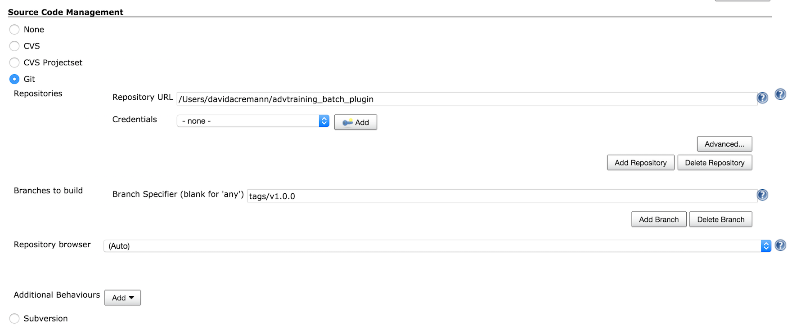
Plugin development
Create a Jenkins release job

Slide 171
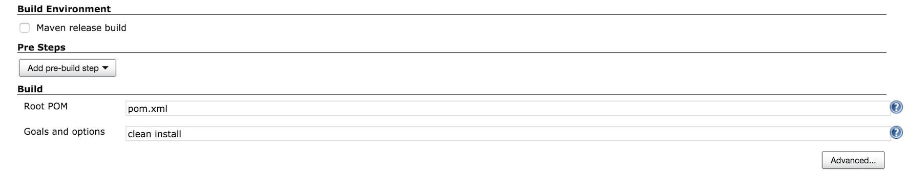
Plugin development
Create a Jenkins release job

Slide 172
Plugin development
Update the plugin
stop.sh.ftl and start.sh.ftl should display the deployed application name in the output log
build a snapshot version and test
commit the changes in git and create a new tag v2.0.0
release the plugin with jenkins
install the new release version

Slide 173
Plugin development
Add automated tests with the CLI
create a jython script using the CLI
use the unittest package
use Assertxxx methods and test :
requested plugin is installed
test application and environments are available
undeploy existing version from test env if any
perform an initial deployment of 1.0
verify success, generated steps and steps output
perform an update to 2.0
verify success, generated steps and steps output
perform an undeploy

Slide 174
Plugin development
Plugin debugging
Use logging for ftl and Jython rules/script (logger.xxx, ctx.logOutput())
use TmpDeleteOnDisconnect = false on remote host to execute remote commmands manually
use JPDA for Java based extensions
JPDA="-Xdebug -Xrunjdwp:transport=dt_socket,server=y,suspend=y,address=8000“
use conf/wrapperxxx configuration file to add DEV classpath locations

Slide 175
UI Plugin development
http://www.xebialabs.com

Slide 176
Plugin development
Introductionsda
This chapter will cover the following topics:
Introduction to UI plugin development
Quick introduction to Angular JS
A simple task list step-by-step

Slide 177
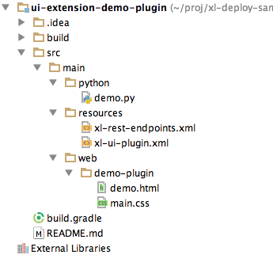
UI Extensions
Introduction
You can extend XL Deploy by creating new endpoints backed by Jython scripts and new UI screens that use these endpoints.

Slide 178
UI Extensions
Adding menu items
xl-ui-plugins.xml
<plugin xmlns:xsi="http://www.w3.org/2001/XMLSchema-instance"
xmlns="http://www.xebialabs.com/deployit/ui-plugin"
xsi:schemaLocation="http://www.xebialabs.com/deployit/ui-plugin xl-ui-plugin.xsd">
<menu id="test.demo" label="Demo" uri="demo.html" weight="12" />
</plugin>

Slide 179
UI Extensions
Declaring server endpoints
xl-rest-endpoints.xml
<?xml version="1.0" encoding="UTF-8"?>
<endpoints xmlns:xsi="http://www.w3.org/2001/XMLSchema-instance"
xmlns="http://www.xebialabs.com/deployit/endpoints"
xsi:schemaLocation="http://www.xebialabs.com/deployit/endpoints endpoints.xsd">
<endpoint path="/test/demo" method="GET" script="demo.py" />
<!-- ... more endpoints can be declared in the same way ... -->
</endpoints>

Slide 180
UI Extensions
Quick introduction to Angular JS
AngularJS is a JavaScript framework
Extends HTML attributes with directives
It can bind data to HTML with expressions

Slide 181
UI Extensions
Quick introduction to Angular JS
ng-directives
:ng-app defines the application
ng-model and ng-bind are used for variable binding

Slide 182
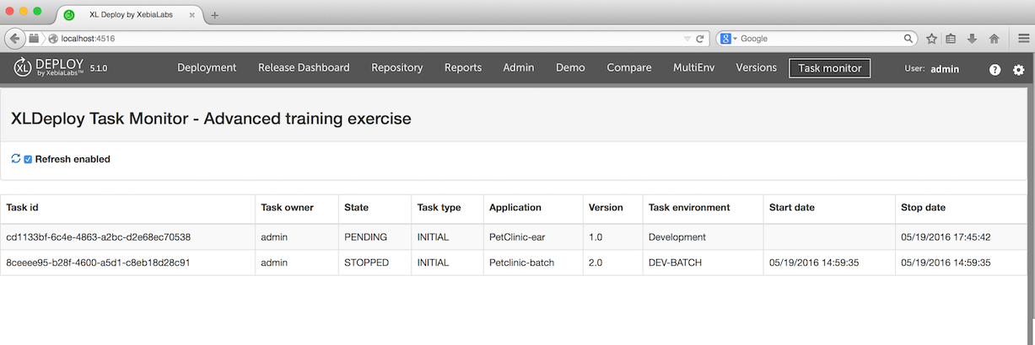
UI Extensions
A simple task-monitor extension
We will mimic the task monitor with a UI extension

Slide 183
UI Extensions
A simple task-monitor extension
Exercise uses :
Angular JS https://angularjs.org
Angular UI bootstrap http://angular-ui.github.io/bootstrap/

Slide 184
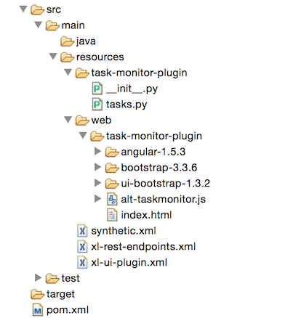
UI Extensions
Exercise setup
Create a new project folder and copy files :

Slide 185
UI Extensions
xl-ui-plugin.xml
<?xml version="1.0" encoding="UTF-8"?>
<plugin xmlns:xsi="http://www.w3.org/2001/XMLSchema-instance"
xmlns="http://www.xebialabs.com/deployit/ui-plugin"
xsi:schemaLocation="http://www.xebialabs.com/deployit/ui-plugin xl-ui-plugin.xsd">
<menu id="xld.alt-taskmonitor.plugin" label="Task monitor"
uri="task-monitor-plugin" weight="100" />
</plugin>

Slide 186
UI Extensions
index.html
<head>
<meta http-equiv="X-UA-Compatible" content="IE=edge"/>
<script type="text/javascript" src="angular-1.5.3/angular.min.js"></script>
<script type="text/javascript" src="ui-bootstrap-1.3.2/ui-bootstrap-tpls-1.3.2.min.js">
</script>
<link rel="stylesheet" href="bootstrap-3.3.6/css/bootstrap.min.css">
<script type="text/javascript" src="alt-taskmonitor.js"></script>
</head>

Slide 187
UI Extensions
index.html application init
<body ng-app="taskApp" ng-controller="taskController" class="ng-cloak" id="taskApp">

Slide 188
UI Extensions
alt-taskmonitor.js
var taskApp = angular.module('taskApp', ['ui.bootstrap']);
taskApp.controller('taskController', ['$scope', '$uibModal', '$filter', 'taskService','$interval', function ($scope, $uibModal, $filter, taskService,$interval) {
$scope.loadTasks = function () {
taskService.getTasks().then(function (tasks) {
$scope.tasks = tasks.entity
});
}
$scope.loadTasks();
}]);

Slide 189
UI Extensions
index.html : the task table
<table class="table table-bordered table-striped">
<thead>
<tr>
<td>
<label>Task id</label>
</td>
UI Extensions
index.html : the task table
..
</thead>
<tbody>
<tr ng-repeat="task in tasks">
<td>{{ task.taskId }}</td>

Slide 190
UI Extensions
alt-taskmonitor.js : access to the tasks
taskApp.factory('taskService', ['$http', '$q', function ($http, $q) {
return {
getTasks: function (query) {
return $http.get('/api/extension/taskmonitor/tasks').then(
function (response) {
console.log(response.data);
return response.data
}
);
}
};
}]);

Slide 191
UI Extensions
xl-rest-endpoints.xml
We add our own task helper to query and shape the information for this UI
<endpoints xmlns:xsi="http://www.w3.org/2001/XMLSchema-instance"
xmlns="http://www.xebialabs.com/deployit/endpoints"
xsi:schemaLocation="http://www.xebialabs.com/deployit/endpoints endpoints.xsd">
<endpoint path="/taskmonitor/tasks" method="GET" script="task-monitor-plugin/tasks.py"/>
</endpoints>

Slide 192
UI Extensions
tasks.py
logger.info("Starting")
taskList = taskBlockService.myCurrentTasks
tList = []
for t in taskList:
logger.info("Task %s %s"%(dir(t), type(t)))
mtask = {"taskId":t.id, "environment":t.metadata["environment"],"taskDescription":t.description,"owner":t.owner,"state":str(t.state), "taskType":str(t.getMetadata()["taskType"]), "application":t.metadata["application"], "version":t.metadata["version"]}
tList.append(mtask)
response.entity = tList

Slide 193
UI Extensions
index.html binding
<tr ng-repeat="task in tasks">
<td>{{ task.taskId }}</td>
<td>{{ task.owner }}</td>
<td>{{ task.state }}</td>
<td>{{ task.taskType }}</td>
<td>{{ task.application }}</td>
<td>{{ task.version }}</td>
<td>{{ task.environment }}</td>
</tr>

Slide 194
UI Extensions
Running the extension
Edit conf/xld-wrapper-xxx.conf
add a wrapper.java.classpath entry (adjust to your project folder):
wrapper.java.classpath.4=/Users/training/alt-taskmonitor/src/main/resources

Slide 195
UI Extensions
Running the extension
restart XL Deploy
reload the UI
test the plugin

Slide 196
UI Extensions
Add a refresh feature
Use the following code snippets to add an automatic refresh of the task
<div class="panel-body">
<a class="glyphicon glyphicon-refresh icon-refresh-animate" title="Refresh"></a>
<label><input type="checkbox" ng-model="refreshEnabled"> Refresh enabled</label>
</div>

Slide 197
UI Extensions
Add a refresh feature
Use the following code snippets to add an automatic refresh of the task
$scope.refreshEnabled = true
....
$interval(function(){
console.log($scope.refreshEnabled)
if ($scope.refreshEnabled === true){
$scope.loadTasks();
};
}.bind(this), 10000);

Slide 198
UI Extensions
Add start date and completion date to the table
from org.joda.time import DateTime
from org.joda.time.format import DateTimeFormat
...
dtf = DateTimeFormat.forPattern("MM/dd/yyyy HH:mm:ss");
...
strStartDate = dtf.print(t.startDate)
strStopDate = dtf.print(t.completionDate)
...
mtask = {"taskId":t.id,..... "startDate":strStartDate, "stopDate":strStopDate}

Slide 199
UI Extensions
Add start date and completion date to the table
<td>
<label>Start date</label>
</td>
<td>
<label>Stop date</label>
</td>
...
<td>{{ task.startDate }}</td>
<td>{{ task.stopDate }}</td>

Slide 200
UI Extensions
Package the plugin
adjust the configuration , build the plugin as a jar and deploy into /plugin

Slide 201
Links
Extra Information
http://xebialabs.com
https://support.xebialabs.com/
see forums for Tips and tricks, announcements, feature requests
http://docs.xebialabs.com
https://github.com/xebialabs-community
http://blog.xebialabs.com

